Slide 1
Welcome!
DESIGNED BY MICHAEL PANAIT FOR HACK CLUB ARCADE
REPLACE (school’s) Hack Club with your Hack Club’s Name!
Feel free to modify anything in this presentation file.
(Your School) Hack Club - OnBoard Meeting
Workshop 1 - Hacker Card

Slide 2

Welcome to OnBoard!
This will be the first Hack Club workshop of this semester! After this, you should receive $100 to put your card into production and build another project for the Spring Ship!
This will be split into 4 sessions - 25 minutes each
Intro to EasyEDA and Schematic Design
EasyEDA PCB Design
EasyEDA PCB Design: Adding a spin!
Submitting your project to JLCPCB and OnBoard

Slide 3
What will we be learning?
Basic Electrical Engineering
PCB Routing and Design
Schematics
Forks, Pushing/Pulling, and Requests in GitHub

Slide 4
Session 1: Setup and Placing Components

Slide 5
Step 1: Make a EasyEDA account
Go to easyeda.com and click Design Online
Launch EasyEDA STD, do not select EasyEDA PRO,
On the top right, click “Register”
Make an account. Please DO NOT USE A SCHOOL EMAIL.
Manually or through Google is fine.

Slide 6
Step 2: Create an EasyEDA Project
Under “Quick Start”, select “New Project”
Set your project title to NFC Hacker Card
Hit “Save”
Now, we’ll show you the rest!

Slide 7
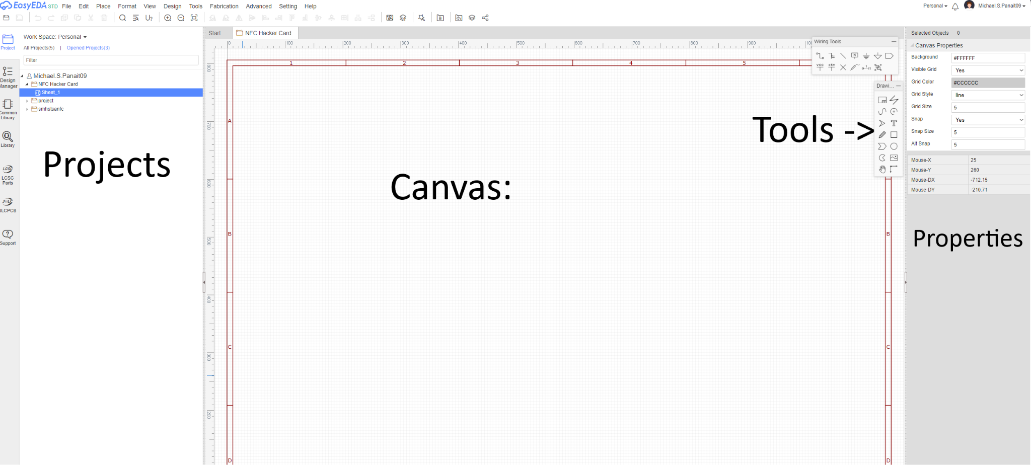
Welcome to the schematic editor!

Slide 8
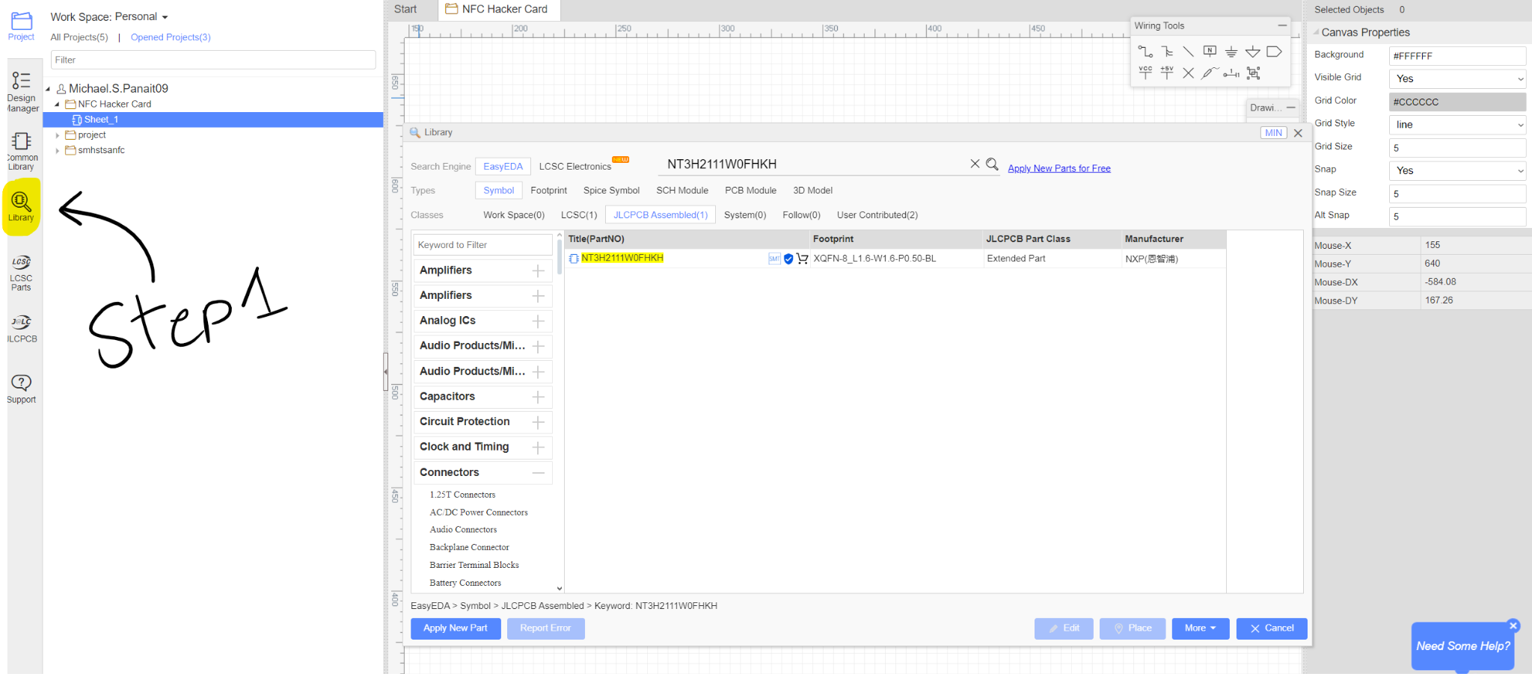
Step 1: Opening Library
This is where you can find every component for every project! Click on the Library
button on the left side bar.

Slide 9
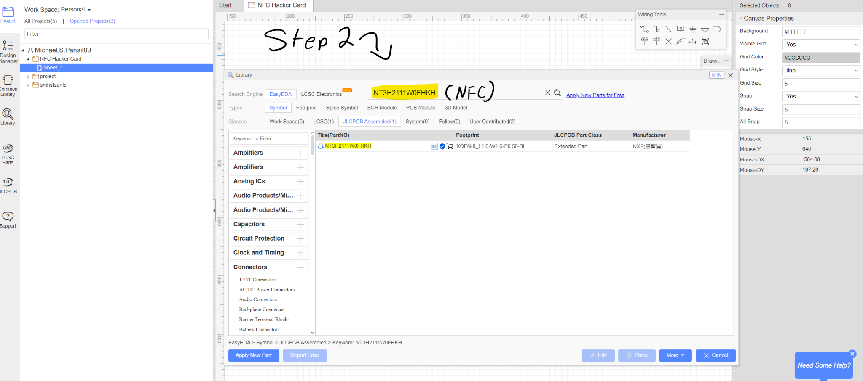
Step 2: Searching LCSC for the NFC Chip
For this, we’ll be using the NXP NTAG I²C 2K chip (NT3H2111W0FHKH). This holds the card’s data, talks to your phone, and powers the electronics on the board. Type it in the search box!

Slide 10
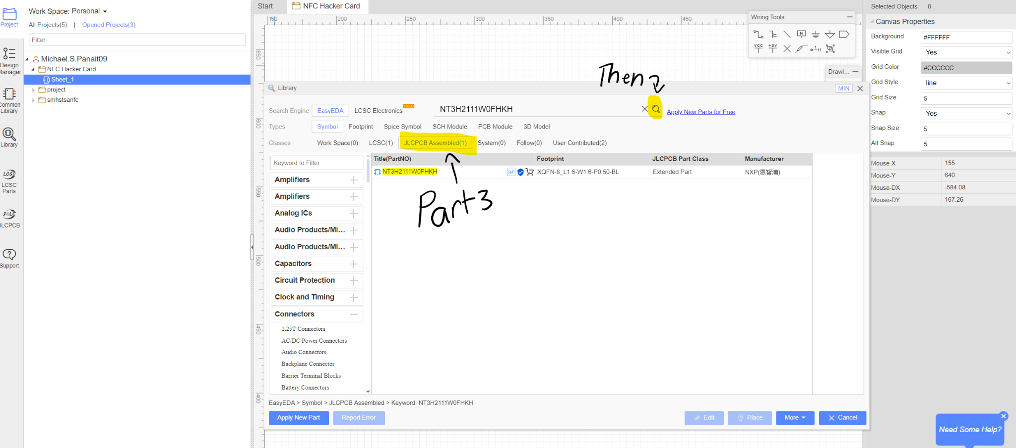
Step 3: Searching LCSC for the NFC Chip
We need to make sure JLCPCB can find the parts for this project, select JLCPCB Assembled on the search options, then hit search.

Slide 11
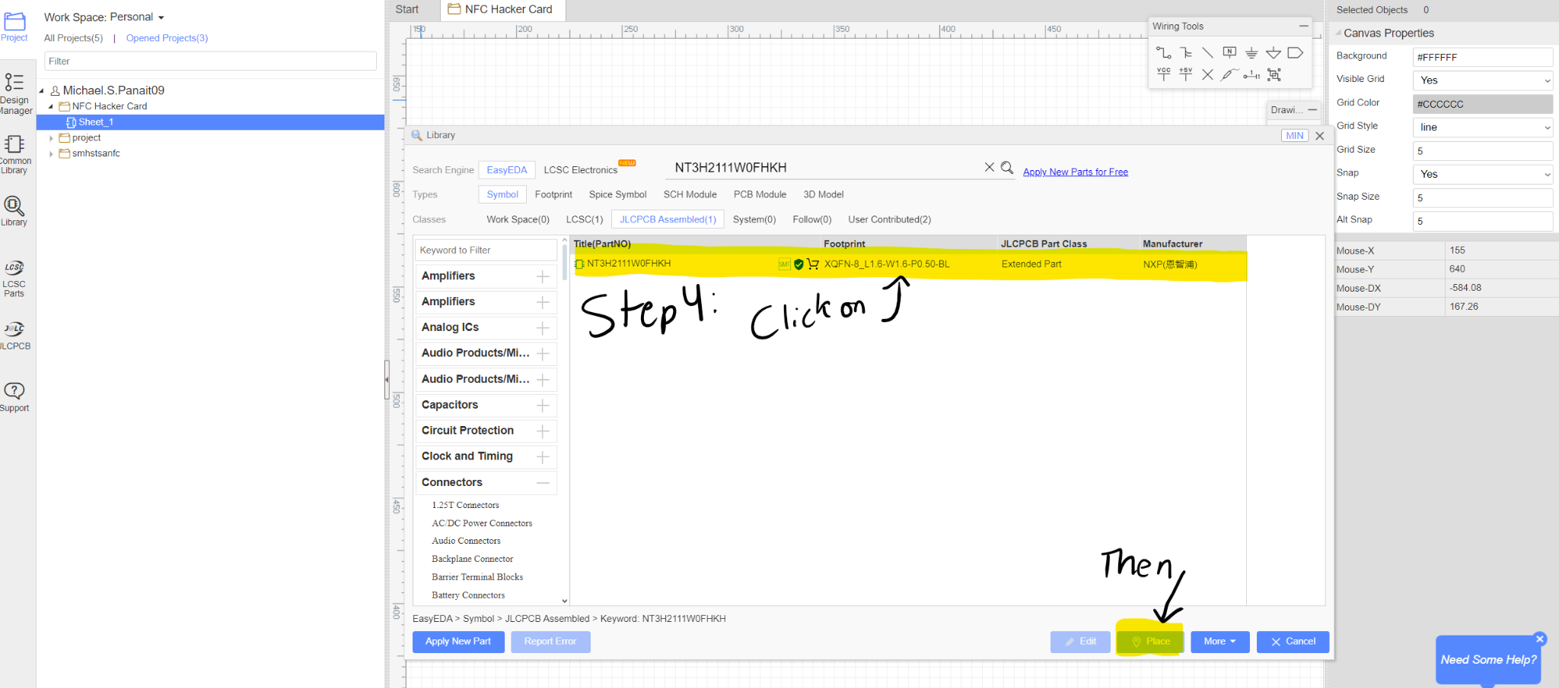
Step 4: Selecting the NFC Chip
There should only be one option, click on the result and select Place to bring the chip into the canvas.

Slide 12
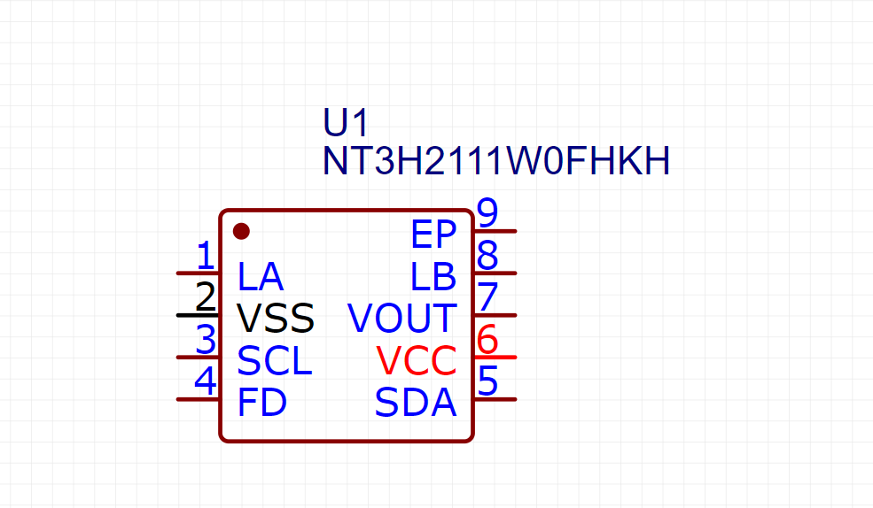
Step 5: Placing the NFC Chip
Click anywhere on the canvas to place the NFC Chip on the canvas. Then, hit ESC to stop placing chips.

Slide 13
Step 6: Adding the other parts:
Repeat steps 1-5 for each of these parts. Here’s what each part means:
17-21SUYC/TR8 - Orange LED - Indicates NFC Status
0603WAF470JT5E - Resistor - Limits the voltage reaching the LED
CL10B224KA8NNC - Capacitor - Acts as a “battery” for the NFC Chip

Slide 14
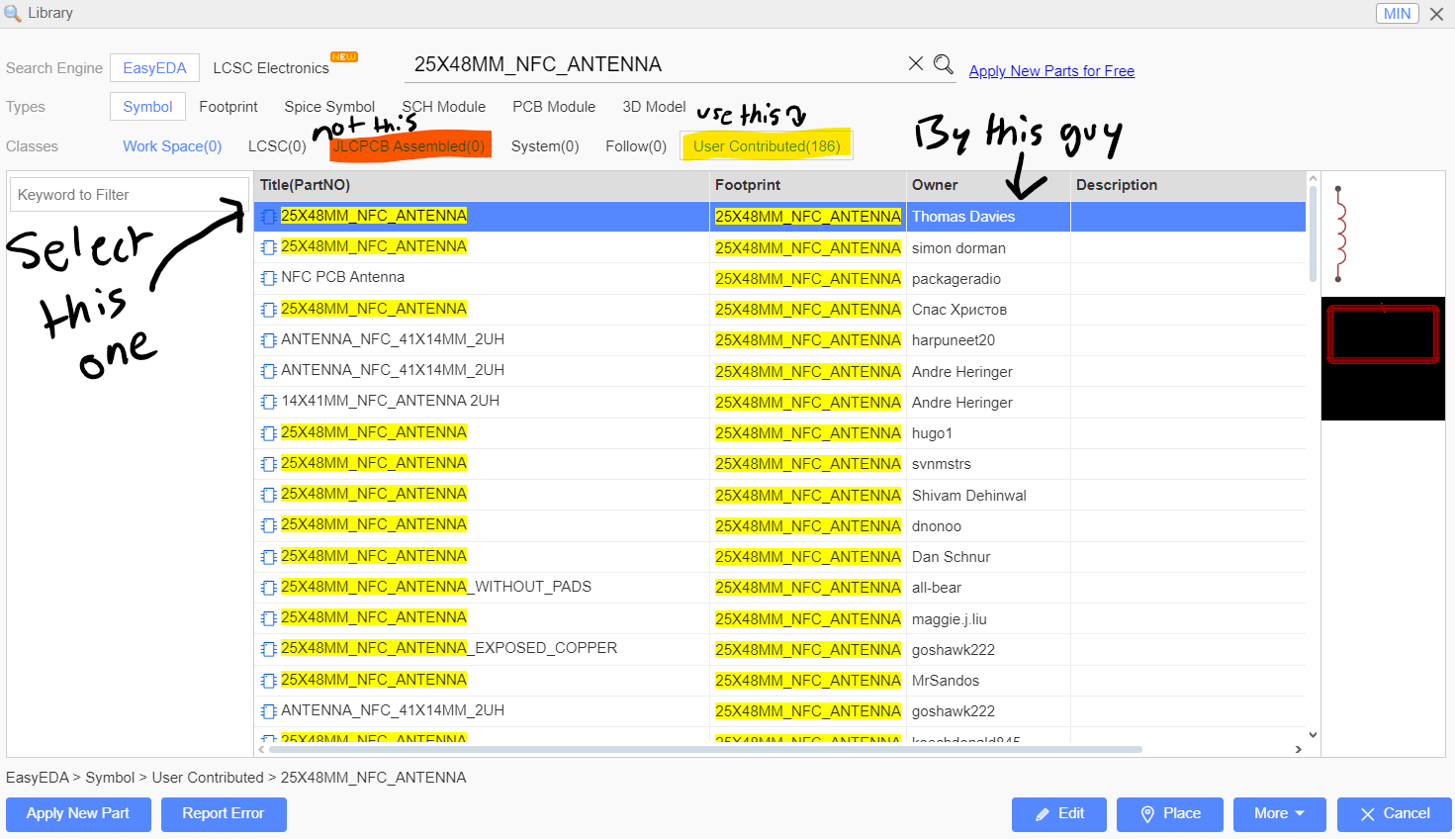
Step 7: Adding the NFC Antenna
The NFC Chip can’t talk to a phone without an antenna, so let’s add it! However,
the steps are a bit different:

Slide 15
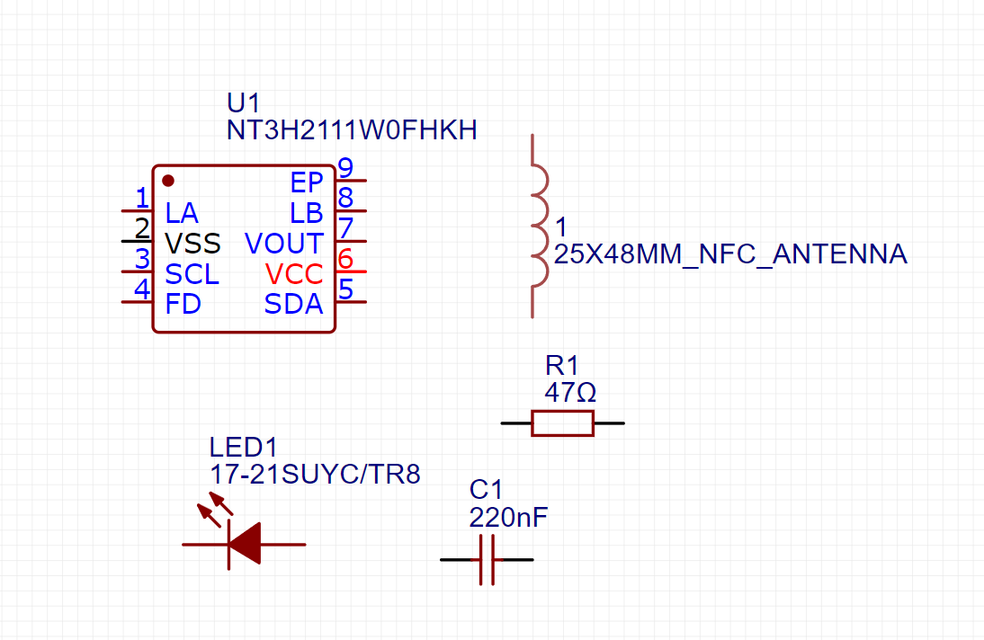
The Final Result!
Your canvas should look similar to this:
Remember: Ctrl + S to Save!

Slide 16
Thanks for coming!
See you at the next meeting on ________ (08/XX/2X)

Slide 17
Welcome!
DESIGNED BY MICHAEL PANAIT FOR HACK CLUB ARCADE
REPLACE (school’s) Hack Club with your Hack Club’s Name!
Feel free to modify anything in this presentation file.
(Your School) Hack Club - OnBoard Meeting
Workshop 1 - Hacker Card

Slide 18
Session 2: Sketmatics

Slide 19
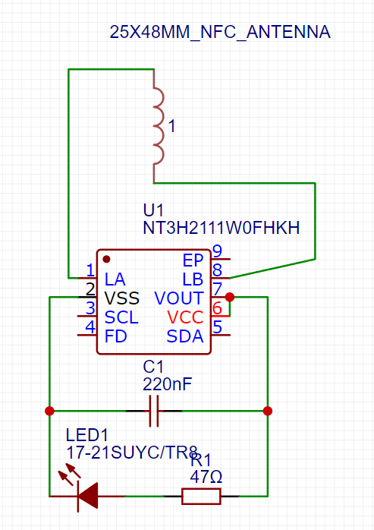
Before we begin, what is a schematic?
A schematic is a technical drawing that indicates where wires in a PCB should connect to. The schematic on the
right is what you’ll be making today!

Slide 20
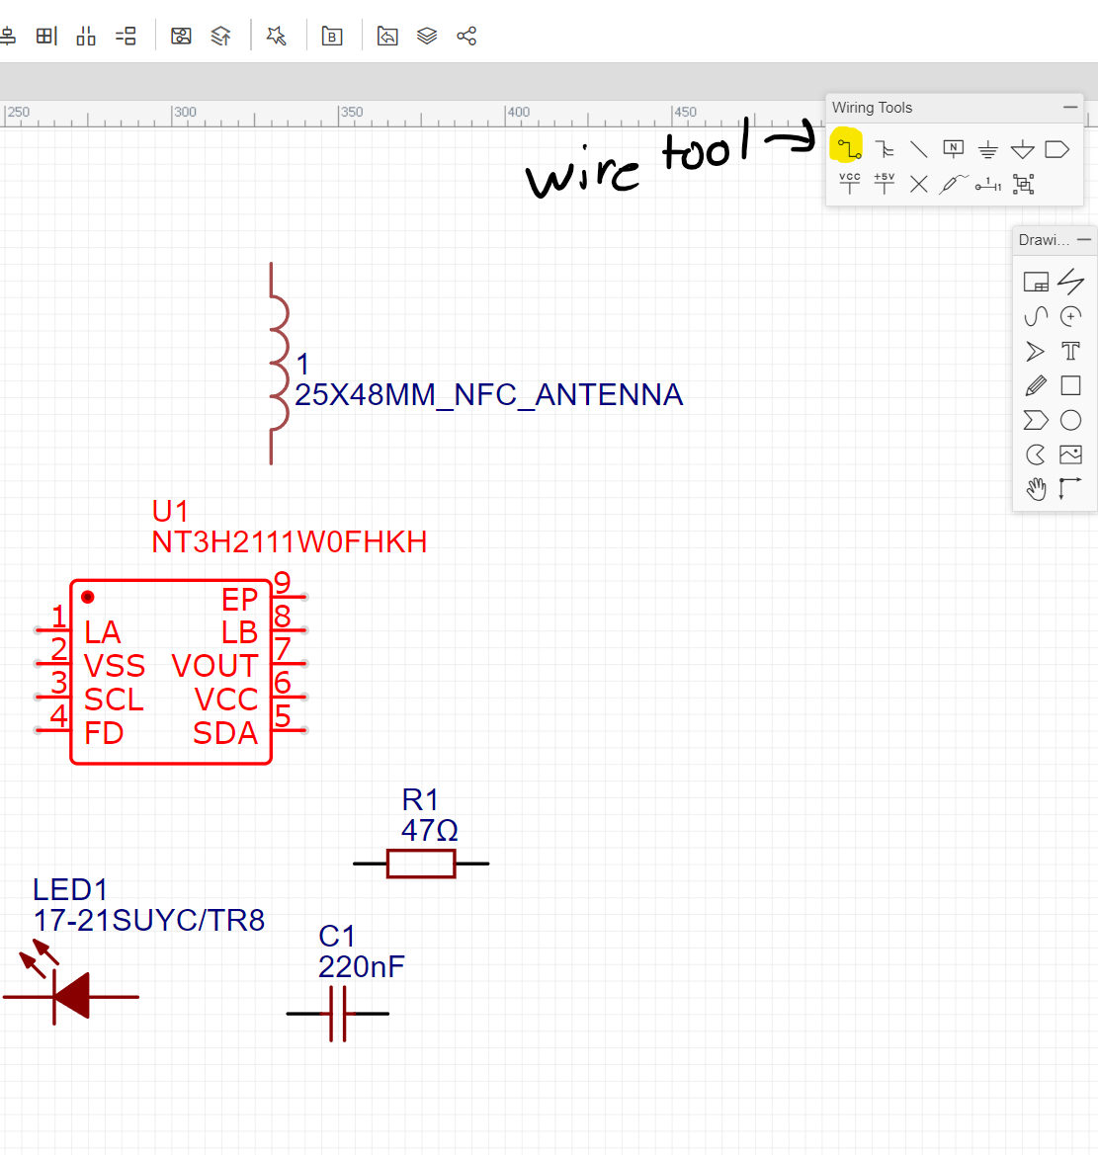
Part 1: Wiring
Use the Wire tool to “connect” components together. Since the datasheet for the NFC chip requires a capacitor between VOUT (+) and VSS (-). We’ll need to indicate that on our schematic:
Try it for yourself!

Slide 21
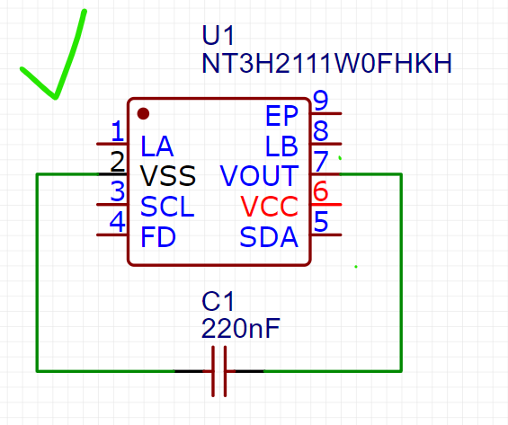
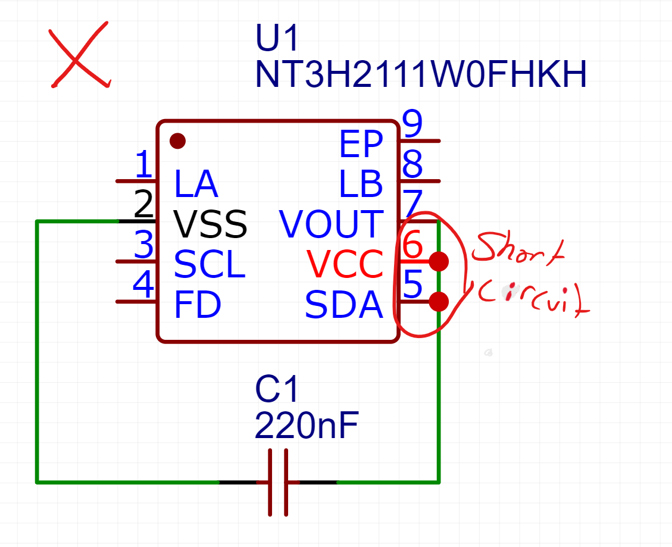
Part 1: Wiring
Make sure the wires aren’t touching!

Slide 22
Step 3: Connect the NFC Antenna
Now, we’ll need to give the NFC chip way to talk! Hook up each side of the antenna to LA and LB respectively on the chip.
Try doing this on your own!

Slide 23
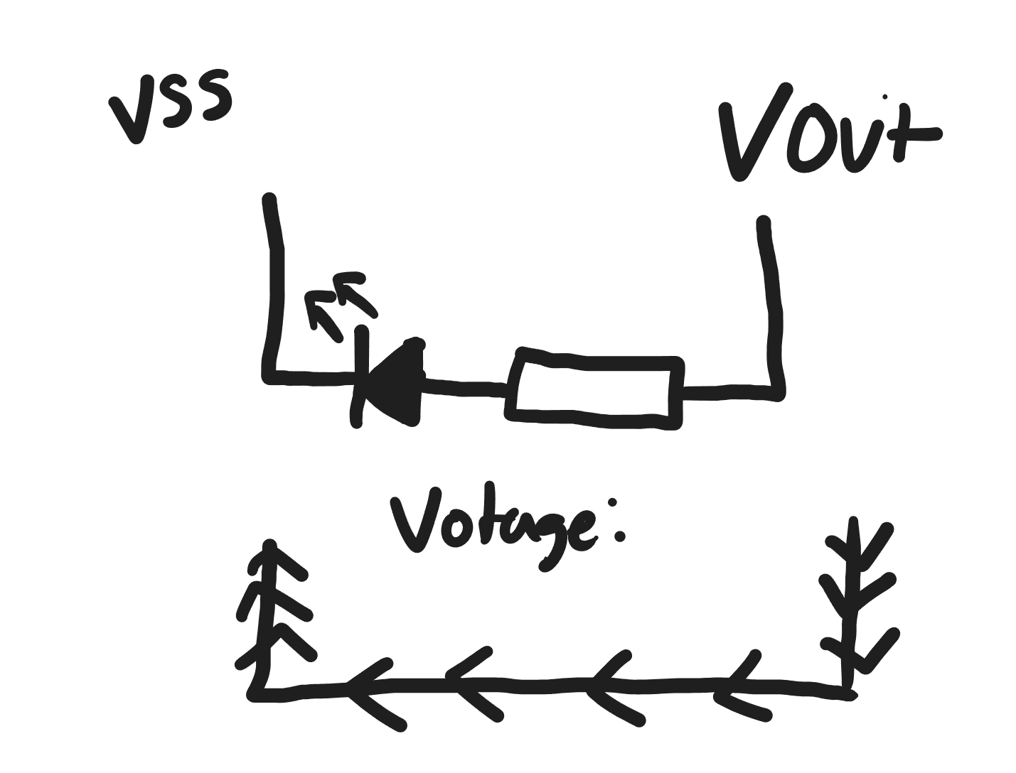
Step 4: Bridge the chip and connect the LED
Next, connect the VCC and VOUT together. Since the chip is expecting power from a MCU, bridging this pin feeds power from the phone to power the chip.
Next, power the LED like so:

Slide 24
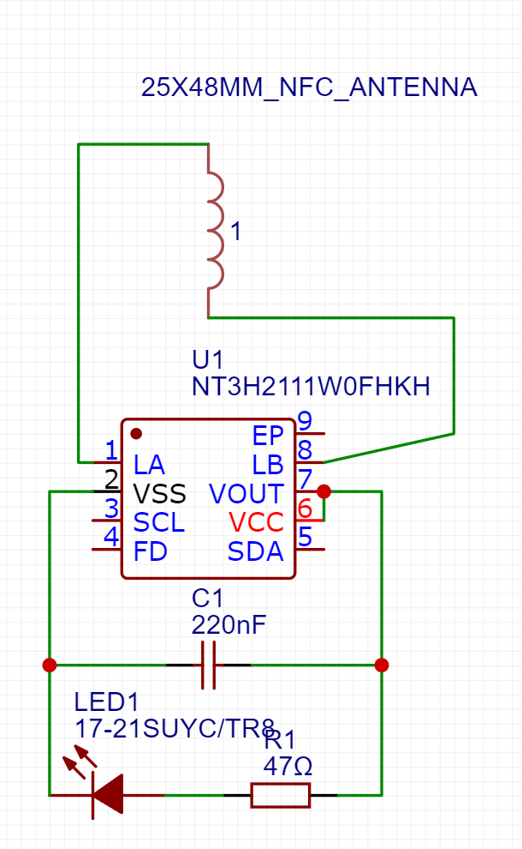
Step 5: Checking your schematic:
You’re done for now! Check out this picture to see
if yours matches the one onscreen.

Slide 25
Thanks for coming!
See you at the next meeting on ________ (08/XX/2X)

Slide 26
Welcome!
DESIGNED BY MICHAEL PANAIT FOR HACK CLUB ARCADE
REPLACE (school’s) Hack Club with your Hack Club’s Name!
Feel free to modify anything in this presentation file.
(Your School) Hack Club - OnBoard Meeting
Workshop 1 - Hacker Card

Slide 27
Session 3: PCB Design - Part 1

